Slide 1
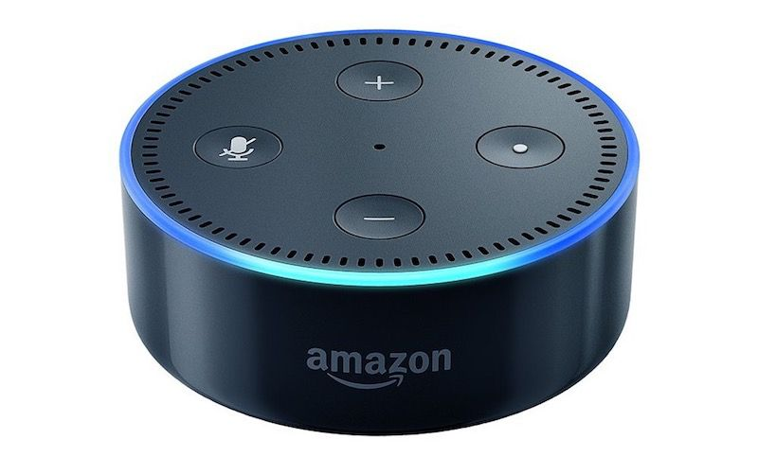
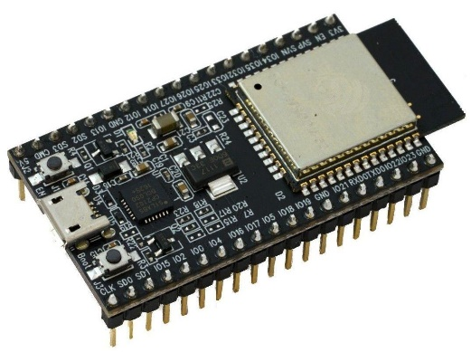
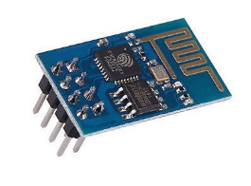
Alexa steuert ESP LED
Alexa: Suche Geräte
Alexa: Schalte „Sepp“ EIN
Alexa: Schalte „Sepp“ AUS
https://github.com/esp8266/Arduino
https://github.com/igorantolic/esp32-alexa-wemo-emulator
Notes:
R2D2 Droid BB-8 C3po

Slide 2
Alexa – Beispielocde für ESP32
#include <WiFi.h>
#include "WemoSwitch.h"
#include "WemoManager.h"
#include "CallbackFunction.h"
boolean connectWifi();
//on/off callbacks
void lightOn();
void lightOff();
char ssid[] = „xxxxxx"; // your network SSID (name)
char password[] = „xxxxxxx"; // your network key
WemoManager wemoManager;
WemoSwitch *light = NULL;
const int ledPin = 2;

Slide 3
Alexa – Beispielocde für ESP32
void setup()
{
// Attempt to connect to Wifi network:
Serial.print("Connecting Wifi: ");
Serial.println(ssid);
WiFi.begin(ssid, password);
while (WiFi.status() != WL_CONNECTED) {
Serial.print(".");
delay(500);
}
Serial.println("");
Serial.println("WiFi connected");
Serial.println("IP address: ");
IPAddress ip = WiFi.localIP();
Serial.println(ip);
wemoManager.begin();
}

Slide 4
Alexa – Beispielocde für ESP32
// Format: Alexa invocation name, local port no, on callback, off callback
light = new WemoSwitch("sepp", 80, lightOn, lightOff);
wemoManager.addDevice(*light);
pinMode(ledPin, OUTPUT); // initialize digital ledPin as an output.
delay(10);
digitalWrite(ledPin, HIGH); // Wemos BUILTIN_LED is active Low, so high is off
}

Slide 5
Alexa – Beispielocde für ESP32
void loop()
{
wemoManager.serverLoop();
}
void lightOn() {
Serial.print("Switch turn on ...");
digitalWrite(ledPin, HIGH);
}
void lightOff() {
Serial.print("Switch turn off ...");
digitalWrite(ledPin, LOW);
}

